Slide 1
www.infoleducation.com

Slide 2
WELCOME BACK

Slide 3
To understand bullying an educator needs to understand (power,oppression, violence and prejudice in different groups).

Slide 4
POWER: Those who educate use the power they have to empower the educating subject by equipping him with the ability to voluntarily and morally carry out his actions.

Slide 5
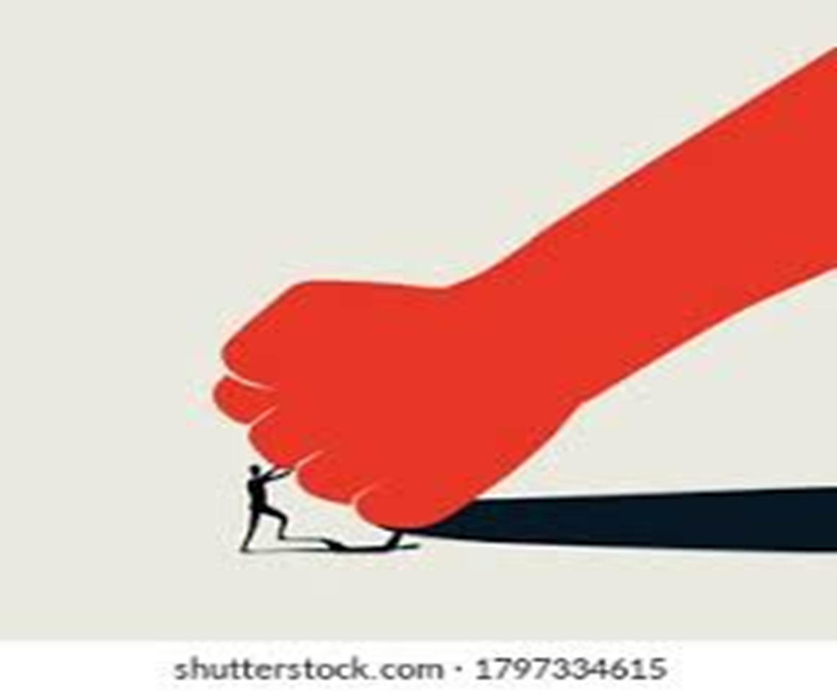
OPPRESSION: Inequality in academic achievements reflects not only differences in terms of students’ effort, skills, or resilience, but also systematic obstacles some (groups of) students face because of their social background.

Slide 6
PREJUDICE AND STEREOTYPES: INTENTIONAL OR UNINTENTIONAL

Slide 7
GENDER BIAS
GENDER BIAS: TREATING ONE GENDER DIFFERENT THAN OTHERS
(STEM GAP, BEHAVIOUR, CLEANINGNESS OF THE CLASSROOM, ETC)

Slide 8
RACIAL BIAS
CATEGORIZING STUDENT BEHAVIOUR BASED ON ETHNICITY AND CULTURE

Slide 9
ABLEISM
Ability is so central to schooling. What happens when a student has different abilities and talents?
(ex. Assuming competencies, talking to an older student with disability with baby voice, offering unsolicited help and advice)

Slide 10
TEACHING STRATEGIES
COOPERATIVE LEARNING
STEFANO ROSSI METHOD
PEER TUTORING
FLIPPED CLASSROOM

Slide 11
COOPERATIVE LEARNING
(THE STEFANO ROSSI METHOD- COOPERATIVE DYDACTIC IN DIFFICULT CLASSROOMS)

Slide 12
COOPERATIVE LEARNING IS DIFFERENT FROM GROUPWORK
GROUP WORK MAY ALLOW BRILLIANT STUDENTS TO PERFORM WELL.
ON THE CONTRARY, COOPERATIVE LEARNING HAS THE FOLLOWING 5 DISTINCTIVE CARACTHERISTICS:
the first element is POSITIVE INTERDEPENDENCE, which literally binds students to cooperate. Unlike classical group work, cooperative activity can be completed only by combining the strengths of all components;
- The second element concerns SOCIAL SKILLS, which in cooperative learning are subject to observation and evaluation by the teacher;
the third element concerns RESPONSIBILITY: in classical group work the responsa-bility is collective, while in cooperative learning it is individual;

Slide 13
the fourth element is MONITORING, which is generic and optional in group work, but specific and essential in cooperative learning, finally
the fifth element is EVALUATION, which is collective in group work, butindividual in cooperative learning.

Slide 14
STEFANO ROSSI METHOD
«COOPERATIVE LEARNING»

Slide 15
The Rossi Method proposes cooperative teaching characterized by five elements of innovation:
the triphasic lesson
micro-groups
Third element: empathy
Fourth element: cooperative formats
5 Fifth element: few minutes to discuss learning activities

Slide 16
TRIPHASIC LESSON:
OPENING LECTURE
(max 20 minutes because of the level of attention of today’s students

Slide 17
2. COOPERATION: micro-groups, work for about 25 minutes.

Slide 18
In this phase, students adhere to formats and use creative ways of addressing the social issues discussed (like bullying)

Slide 19
It is their responsibility to find solutions, and to ensure that all students have understood the topic object of discussion

Slide 20
This allows real cooperation, some students will be «teaching», others will be «mediating». This needs to happen within 25 minutes

Slide 21
The last part is:
FINAL REFLECTIONS

Slide 22
This will be an opportunity to reflect on one or more of the following aspects:
disciplinary reflection (clarification, common mistakes but also integration of thespecific teaching topic);
cultural reflection (thinking critically together);- social reflection (reflecting on the positive aspects and difficulties encountered du-ranting together);

Slide 23
emotional reflection (bringing out emotions and experiences, including personal le-gate to the proposed theme).
It will be up to the teacher to determine from time to time which of these collective reflections

Slide 24
2. MICRO-GROUPS
THE MICROGROUP HAVE A MAXIMUM OF 6 STUDENTS IN IT
THIS ALLOWS EVERY STUDENT TO CONTRIBUTE (IN FACT LARGER GROUPS TEND TO DISPERSE THE SHY OR THE NOT SO MOTIVATED STUDENTS)

Slide 25
STUDENTS ARE SELECTED ACCORDING TO:
HETEROGENEITY, WHICH INVOLVES COOPERATION AMONG STUDENTS WITH DIFFERENT ABILITIES
PROSOCIALITY, TO AVOID, AT LEAST IN THE BEGINNING, FORMING PAIRS AND TRIPLETS BETWEEN STUDENTSWHO HAVE PRIOR CONFLICTS.

Slide 26
BEFORE STARTING WITH COOPERATIVE WORK, A SIMPLE QUESTIONNAIRE WITH TWO QUESTIONS SHOULD BE SUBMITTED TO ALL STUDENTS.QUESTIONNAIRE WITH TWO QUESTIONS, WHICH THEY ANSWER INDIVIDUALLY AND IN WRITING.A. STATE THE NAMES OF THREE CLASSMATES WITH WHOM YOU WOULD LIKE TO WORK IN GROUPS.B. STATE THE NAMES OF THREE CLASSMATES WITH WHOM YOU THINK YOU WOULD HAVE SOME DIFFICULTY IN GROUP WORK.

Slide 27
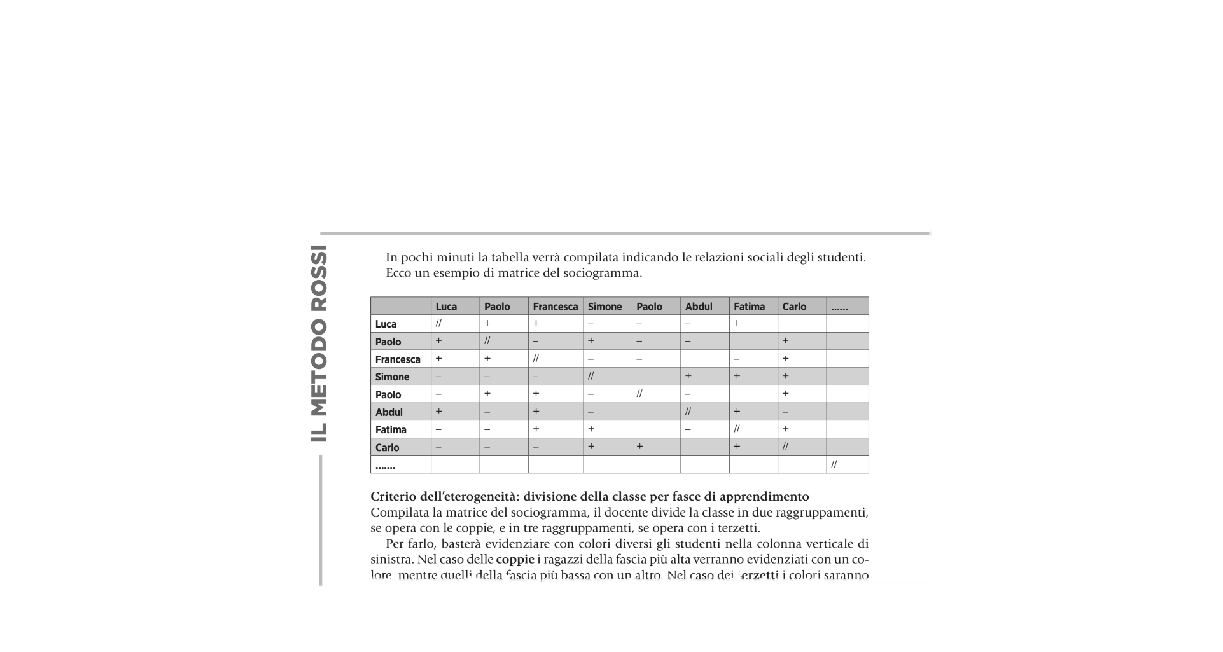

Slide 28
3. EMPHATHY IT IS A MODEL THAT NEEDS TO BE CARRIED OUT FOR 2 TO 4 WEEKS FOR IT TO BE EFFECTIVE IT ALLOWS STUDENTS TO WORK ON EMPHATHY UNDER THE SUPERVISION OF THE TEACHER

Slide 29
4. FORMATS
The fourth element of the Rossi Method concerns cooperative formats, working are already designed to propose the competencies required by the regulations. They are divided by subjects.The teacher does not have to struggle in devising and designing cooperative activities, but has at his disposal some cooperative formats.

Slide 30
COOPERATIVE FORMATS FOR DISCIPLINARY KNOWLEDGE AND SKILLS, USEFUL FOR WORKING INCOOPERATIVELY ON TEXTS, EXERCISES, BUT ALSO IN WRITING, MAKING NOTES.TIONS, AS IN MAKING MAPS, REVIEWING TOGETHER, ETC;

Slide 31
COOPERATIVE formats for critical thinking, in which students can learn to pen-be and reflect on the proposed learning while developing valuable skills of citizenship

Slide 32
cooperative formats for reality tasks, open-ended, challenging problems set in anauthentic context. It is within these specific reality tasks that we can train,develop and unleash the cooperative genius of our students. The Rossi Method involves.Micro-reality tasks that are agile and easily integrated into daily teaching.

Slide 33
RELATIONSHIP BETWEEN BULLYING AND EDUCATIONAL ENVIRONMENT
“THE LEVEL OF IRRITABILITY AND VANDALISM IS HIGHER WHERE THE ENVIRONMENT INITIALLY LOOKS SLOPPY, SHABBY

Slide 34
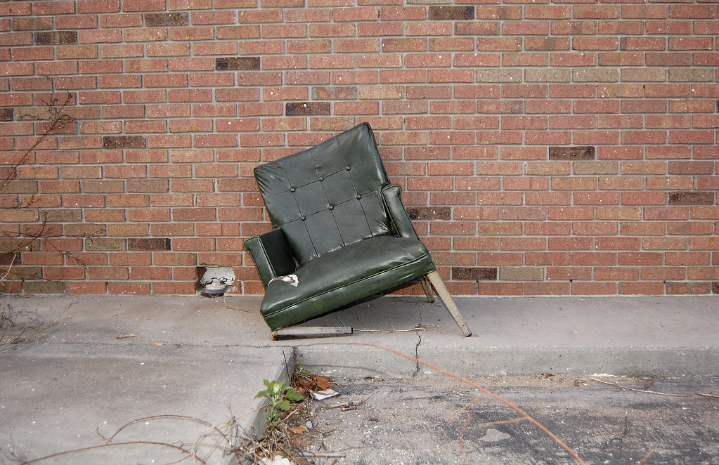
“In other words, if one window is broken or one chair is broken, you can expect other ones to be broken soon. An unwelcoming environment is detrimental to the feeling of comfort and safety and becomes a fertile soil for bullying.”
Bullying also occurs where children have nothing to do in their free time; in that case they can amuse themselves by humiliating the weak. In a diverse environment with a variety of activity options, there will be less time for bullying.

Slide 35
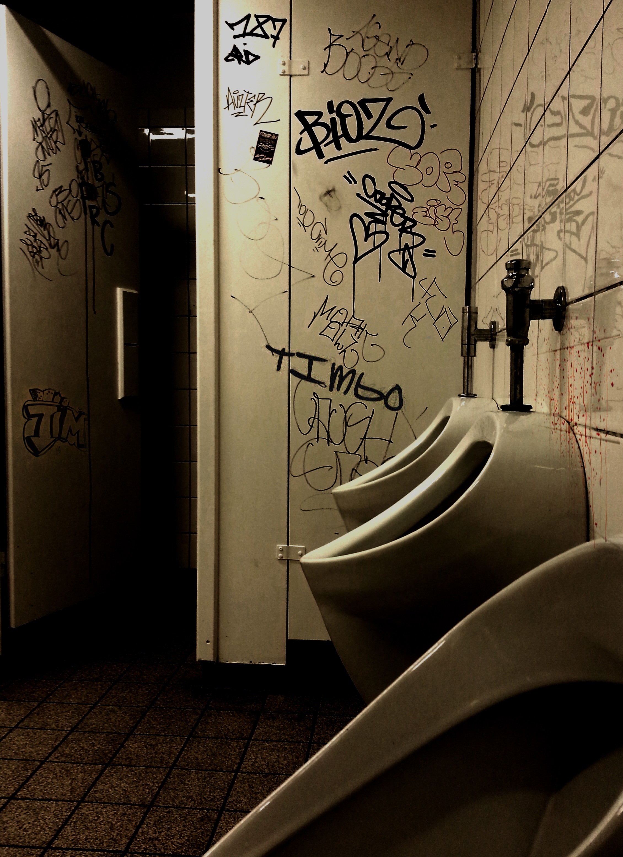
V Toilets are in plain sight, in passageways
X Toilets are out of sight, in dead ends, at the ends of corridors

Slide 36
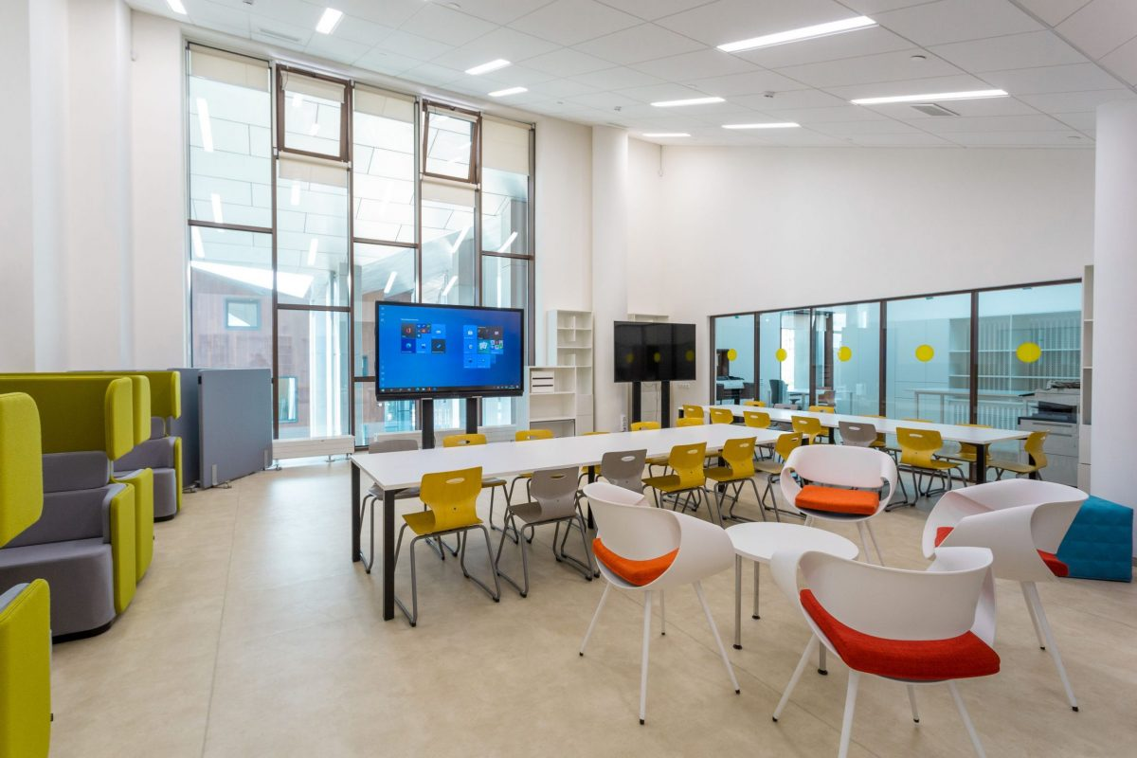
VIEWABLE CLASSROOMS
Classrooms which cannot be viewed from the corridor
Transparent door or floor-to-ceiling windows overlooking the hallway/recreational area

Slide 37
